Slide 1

CS+Social Good
Ideate

Slide 2
Recap
Last week:
Empathized with people in a problem space.
Interviewed one or more people
Observed people
Read people’s stories/perspectives of the situation
Immersed yourself in their situation by looking for resources/communities they have (i.e. facebook groups, etc.)
SHARE: What is something you learned? Something new you experienced?
Notes:
5 minutes

Slide 3
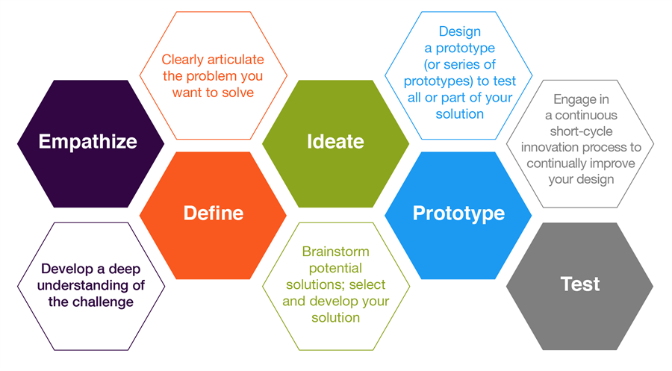
Design Thinking
Notes:
Transition from steps:

Slide 4

Notes:
Spend 3-5 minutes discussing the one challenge and problem statement they’re focusing on.
What from your observations/interviews made you realize this was a problem for your user?
**Note: tell teams that already have ideas to very clearly define the problem statement
Make sure there’s a problem that you’re solving. (e.g. the person that you’re designing for will consider this a problem)

Slide 5

REFRAME
the problem
IMAGINE
wild ideas
Notes:
Ideate is about building innovation potential – not necessary about finding that one great idea.
Brainstorming gets you the seed of what can become innovative solutions (through prototyping and iteration).
We will use brainstorming for ideation.
(Regardless of what ideation technique you use), the core principle is to separate idea generation and evaluation.
Let yourself and your team explore, and turn off the critical part of your brain for just this period of time.

Slide 6

Ideate
In this step, you aim to generate radical design alternatives (going wide) to explore the widest solution space possible. The more diverse the ideas (in number and scope), the more solutions you’ll explore in the prototyping stage.
Goals:
Step beyond obvious solutions, increase innovation potential.
Uncover unexpected areas of exploration
Harness the collective perspectives + strengths of your teams.

Slide 7
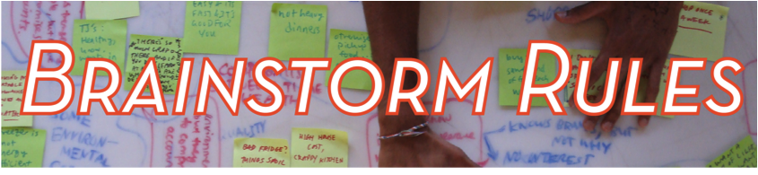
No judgment of both others’ ideas and your own
Write down everything that comes to mind (within reason)
Encourage the wild, the fantastical solutions.
Build on the ideas of others
Be visual
Quantity over quality . . . yes, you heard that right.
Notes:
General rules for brainstorming. Theme: spit out as much as possible, work together, and build on crazy ideas. Don’t judge them immediately, and even write down the ones you *know* are bad -- sometimes, you have to spit out multiple bad ideas in order to get to the good ones.
Make students aware that it’s expected that 90%+ of their ideas will be ridiculous -- the point is to come up with as many crazy solutions as possible. (Note: this doesn’t mean to intentionally look for bad ideas). Afterwards, you’ll continue working.
When you do the brainstorming activity, make it a competition to come up with the most ideas, and the craziest ones. This will make students more engaged!

Slide 8
No judgment of both others’ ideas and your own
Write down everything that comes to mind (within reason)
Encourage the wild, the fantastical solutions.
Build on the ideas of others
Be visual
Quantity over quality . . . yes, you heard that right.
Notes:
Emphasize two most important things:
Don’t judge the ideas
Write as many as possible

Slide 9
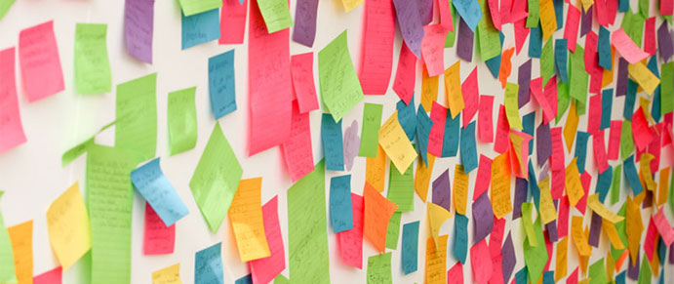
What’s next?
Tomorrow, we’ll be brainstorming solutions to the problem you identified for your user!

Slide 10
REFRAME
the problem
IMAGINE
wild ideas
Notes:
Ideate is about building innovation potential – not necessary about finding that one great idea.
Brainstorming gets you the seed of what can become innovative solutions (through prototyping and iteration).
We will use brainstorming for ideation.
(Regardless of what ideation technique you use), the core principle is to separate idea generation and evaluation.
Let yourself and your team explore, and turn off the critical part of your brain for just this period of time.

Slide 11

Ideate - but first . . .
LET’S PLAN A TRIP!
Notes:
Ideation activity to help get in the mindset
You’re going to brainstorm plans for a trip in your group
Throw out crazy ideas!

Slide 12
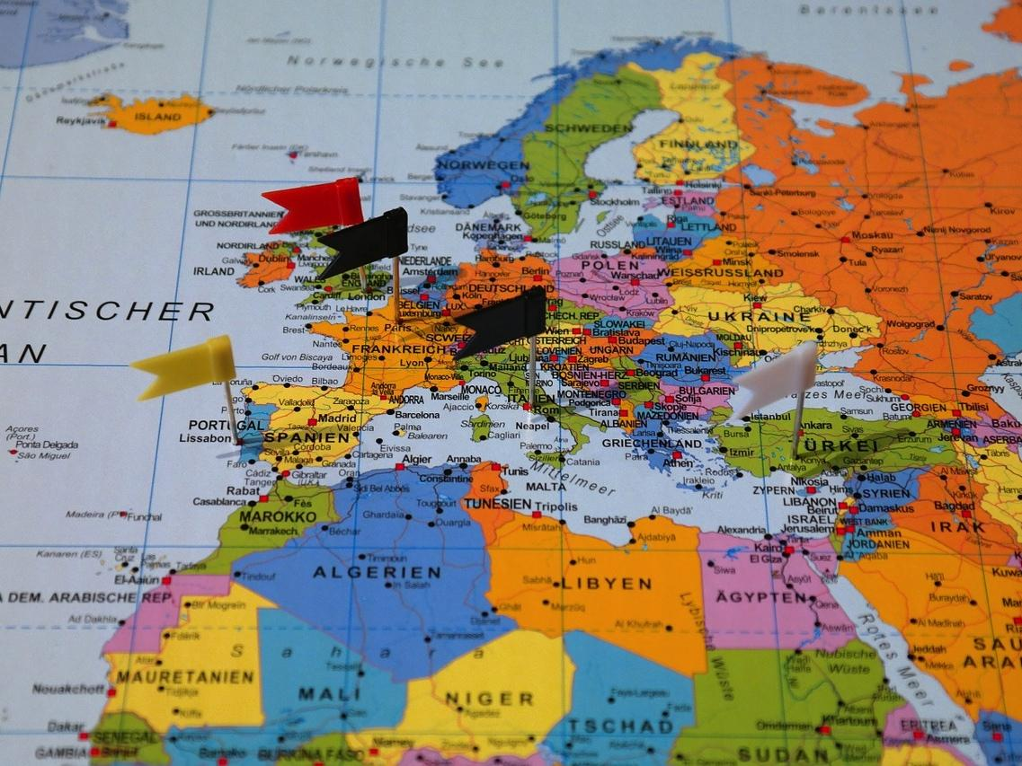
YES, BUT
Notes:
Typically when people are planning things, they say “yes, but,” immediately evaluating ideas and shooting them down
This is harmful for brainstorming
Instead -->

Slide 13

YES, AND
Notes:
Start with a place. Prompt the class: Where’s somewhere you’ve always wanted to go?
Say Yes, And! Build on the ideas of the other person. As soon as you catch yourself saying yes, but to a crazy idea, correct yourself, and build on it.
Spend 3 minutes trying to get as crazy ideas as possible out there.
DEBRIEF THE EXPERIENCE before moving on

Slide 14

Share!
What were some of the craziest ideas you had?

Slide 15
Ideate for your project
Everyone has a pack of post-it notes (everyone on the team should be writing)
Brainstorm! Remember:
Defer judgment
Quantity over quality
Team with the most ideas after 15 minutes will win glory and honor for their team!

Slide 16
No judgment of both others’ ideas and your own
Write down everything that comes to mind (within reason)
Encourage the wild, the fantastical solutions.
Build on the ideas of others
Be visual
Quantity over quality . . . yes, you heard that right.
Reminder: Your solution in your brainstorm doesn’t need technology. Just get ideas!!!
Notes:
Encourage students to come up with as many ideas as possible, even if they don’t seem entirely feasible!

Slide 17
If you get stuck...
How might we redefine [insert problem statement here]?
How would you solve this problem with $1,000,000?
How would you solve this problem with $100?
How would you solve this problem tomorrow?
What would Oprah do?
How would Superman do it?
How would you design it a hundred years from now?
How would you grandma design it?
How would you design for [problem] without technology?

Slide 18



Evaluating Ideas: Dot Voting
three selection criteria
“most impactful/innovative”
“most feasible idea” (implement it tomorrow!)
“most useful/needed”
Notes:
“Most impactful” == if it succeeded, how big of an impact (e.g. Tesla wouldn’t have been likely, but would have a huge impact)
“Feasible” == what’s realistic (probably not making an electric car)
A natural winner will likely arise
Everyone from a group votes once for each category
Time: 5 minutes

